Slide 1

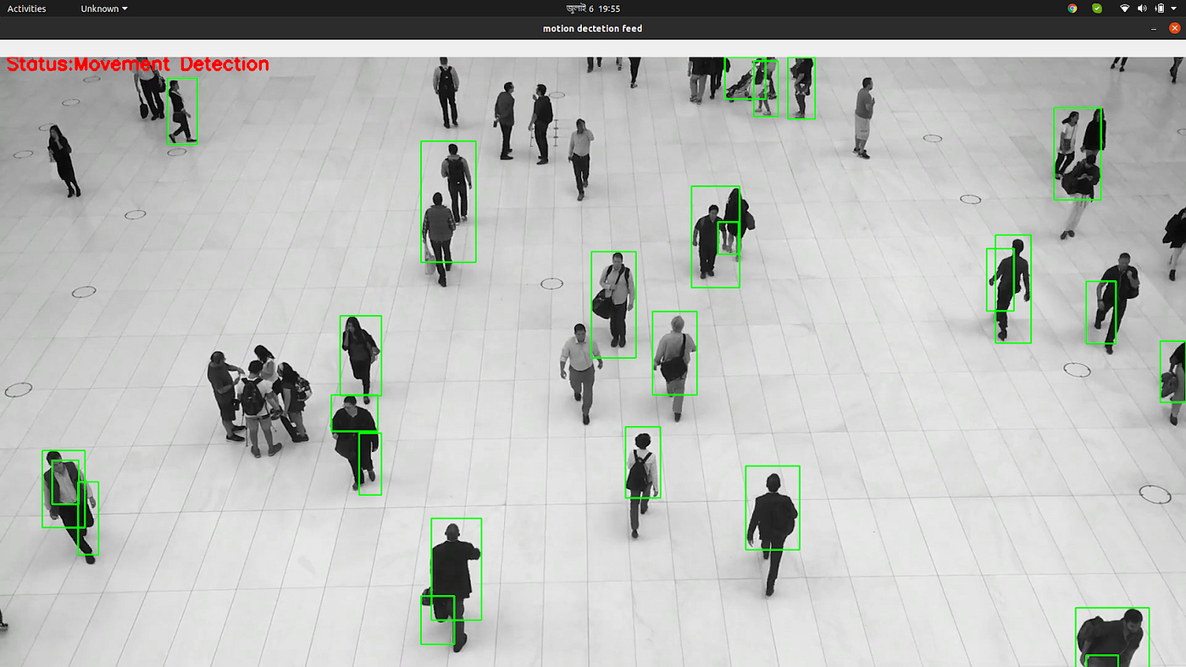
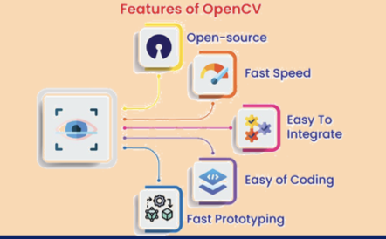
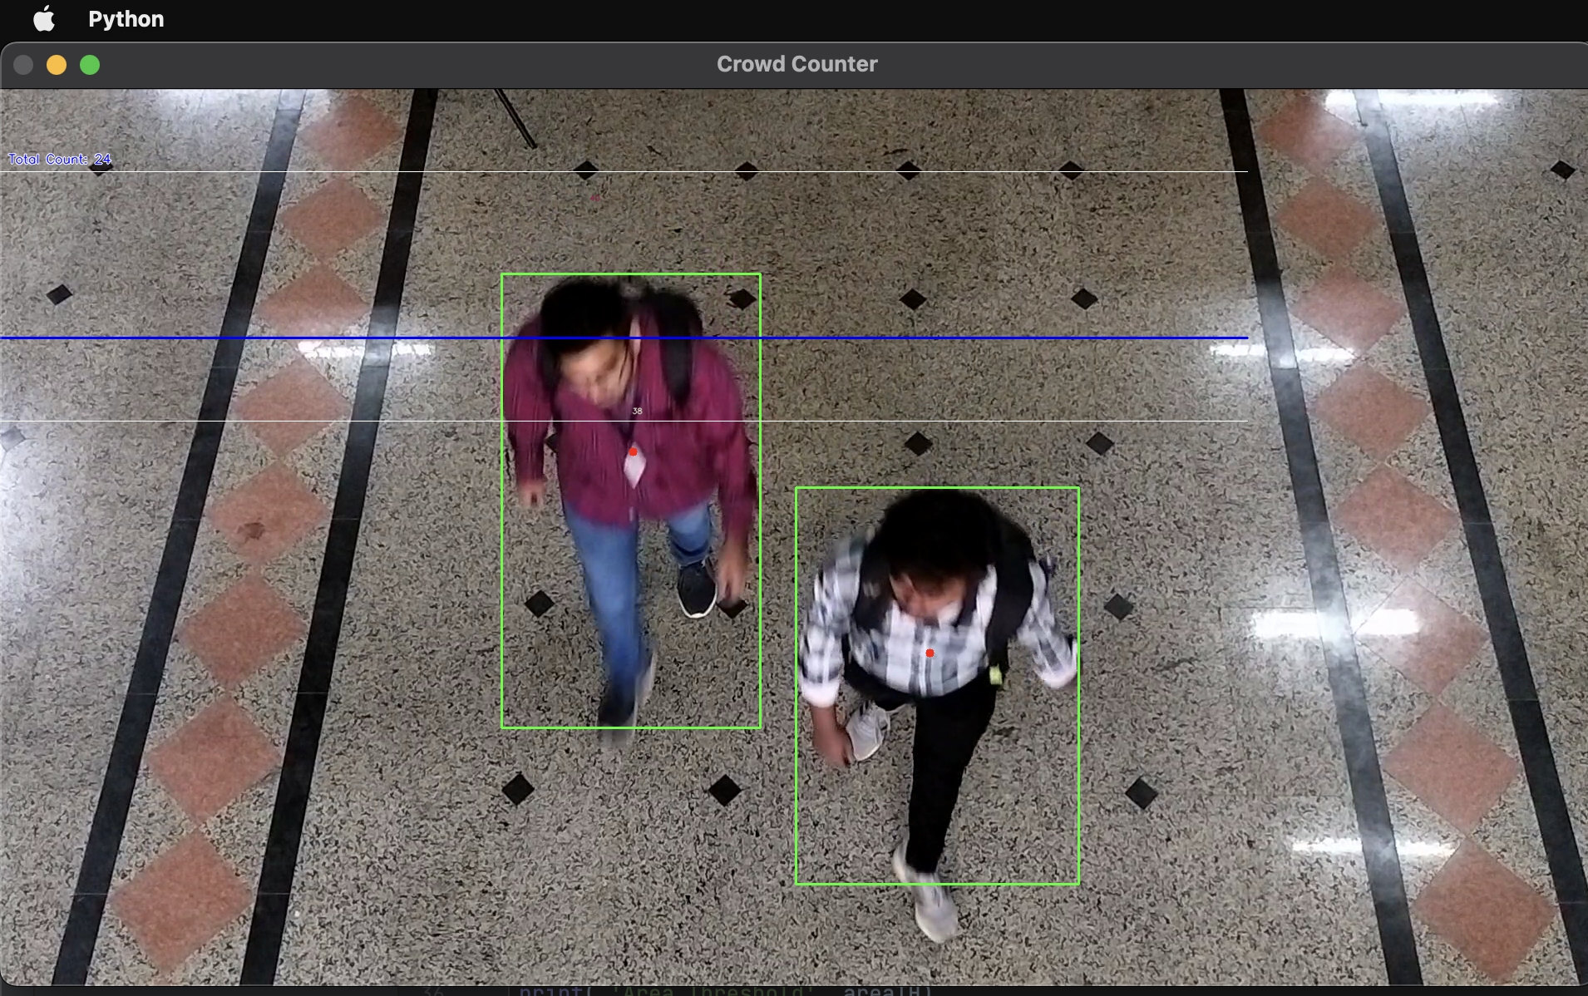
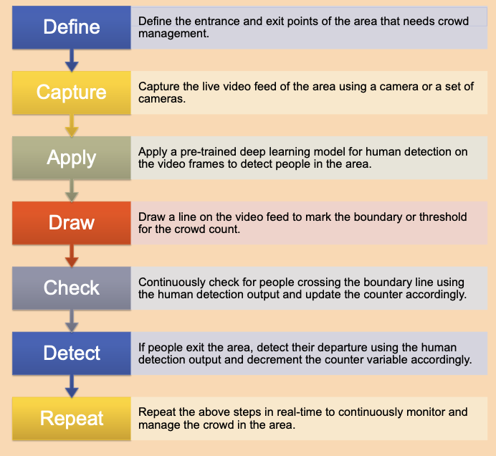
Crowd Management System
Sairaj Abnave, Aditya Adaki, Swapnil Adake, Amit Adhav,
Aditya Bansul, Aditi Bhat
Department of Engineering Sciences and Humanities (DESH)
Vishwakarma Institute of Technology, Pune – 411037
Students’ Conference on Engineering Design and Innovation - June 2023
EDAI 2 PROJECT
GROUP NO
Q09
Introduction
ABSTRACT
RESULTS AND DISCUSSIONS
Crowd monitoring is important for humans in public areas like stations, airports, temples, shopping malls etc.
Crowd management system is used for people detection in the crowd.
Traditional crowd control measures such as physical barriers, police presence, and manual counting of people have limitations in terms of accuracy and speed.
The video surveillance crowd management system is majorly used for public safety.
Determination of the number of people at a particular place helps to avoid any accidental events.
The system was able to detect and track individuals as they moved around the area of interest.
The system was able to alert the authorities when the number of people in the area of interest exceeded a certain threshold.
The system can help improve the overall experience of visitors by preventing long waiting times and congestion.
The system may face some challenges in terms of privacy concerns and data security, which should be addressed through proper regulations and protocols.
INTRODUCTION
Stills from the project-
It has been a challenging task for event organizers and law enforcement agencies to manage large crowds in public space.
Overcrowding, unruly behaviour, and emergencies like fires and terrorist attacks pose significant threats to public safety and security.
With the advent of advanced technologies such as artificial intelligence and the Internet of Things.
It is now possible to develop a smart crowd control management system that can optimize crowd management and enhance public safety.
METHODOLOGY
FLOW CHART
NOVELTY FEATURES / FINDINGS
The key findings of the project include the effectiveness of using computer vision technology for crowd control management.
The importance of fine-tuning pre-trained models for better accuracy, and the need for a robust and scalable system that can handle large volumes of data in real-time.
The project also highlights the potential of using similar systems in other domains, such as security and surveillance.
It highlights the importance of collaboration between researchers, industry professionals, and policymakers in developing effective solutions for public safety.
CONCLUSIONS
In conclusion, the development of the crowd control management system has shown promising results in managing crowds in public spaces.
The system provides real-time monitoring of crowd density and movement, which can help in predicting potential crowding and prevent any safety hazards.
By using advanced computer vision techniques and deep learning algorithms, the system can detect and track individuals in a crowded environment.
TESTING / IMPLEMENTATION
Dataset Collection
Installing all the required pre-trained models on the machine.
Once the dataset was ready, we used a pre-trained deep learning model for human detection and fine-tuned it on our dataset.
We used the popular YOLOv3 architecture for this purpose and trained it on a GPU-powered machine for faster processing.

